Slide 1


Sailing Through Microbial Seas
A Workshop on Charting Microbial Ecology Data
Dr Pedro Lebre
Elise Nghalipo

Slide 2
Aim of the Workshop
This workshop aims to empower Namibian researchers with the
knowledge and practical know-how to conduct microbial ecology
research using next-generation-sequencing (NGS) platforms and the
most up-to-date bioinformatics tools available.

Slide 3
Outline for the workshop
Day 1
The importance of next-generation sequencing technologies (NCBI) for Microbial Ecology studies
The use of taxonomy marker genes to investigate microbial community composition
Introduction to R-studio and Set-up
Processing of short-read data using DADA2
Day 2
Trouble-shooting/ revision of concepts learned in the previous day
Introduction to biodiversity metrics: alpha- and beta-diversity
How to visually represent biodiversity metrics using Rstudio
(Cont)

Slide 4
Outline for the workshop (Cont.)
Day 3
Trouble-shooting/revisions of concepts learned in the previous day
Exploring the composition of your microbial communities
Correlations and connections between taxa.
Looking for potential drivers of community compositions
Take-home messages and end of workshop

Slide 5
Day 1

Slide 6
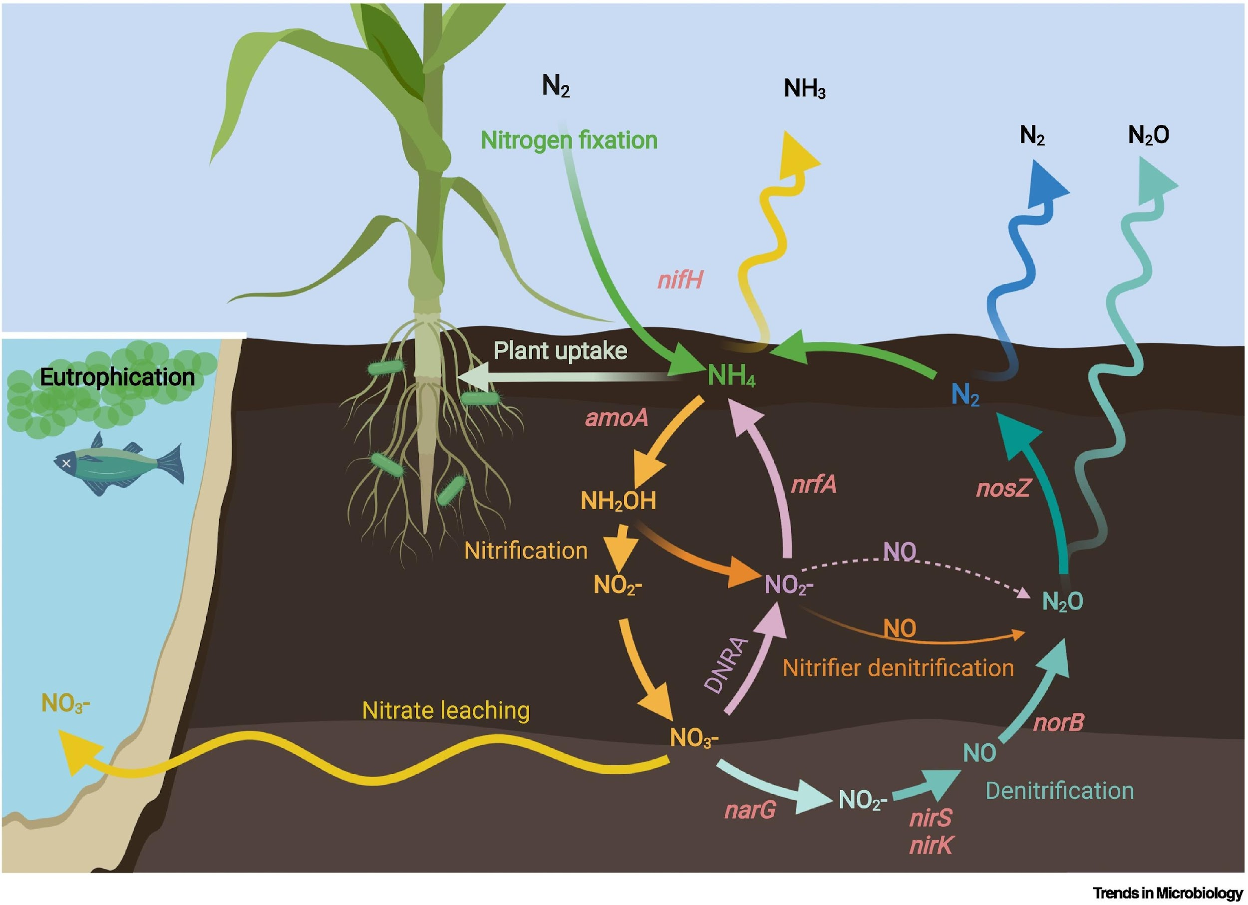
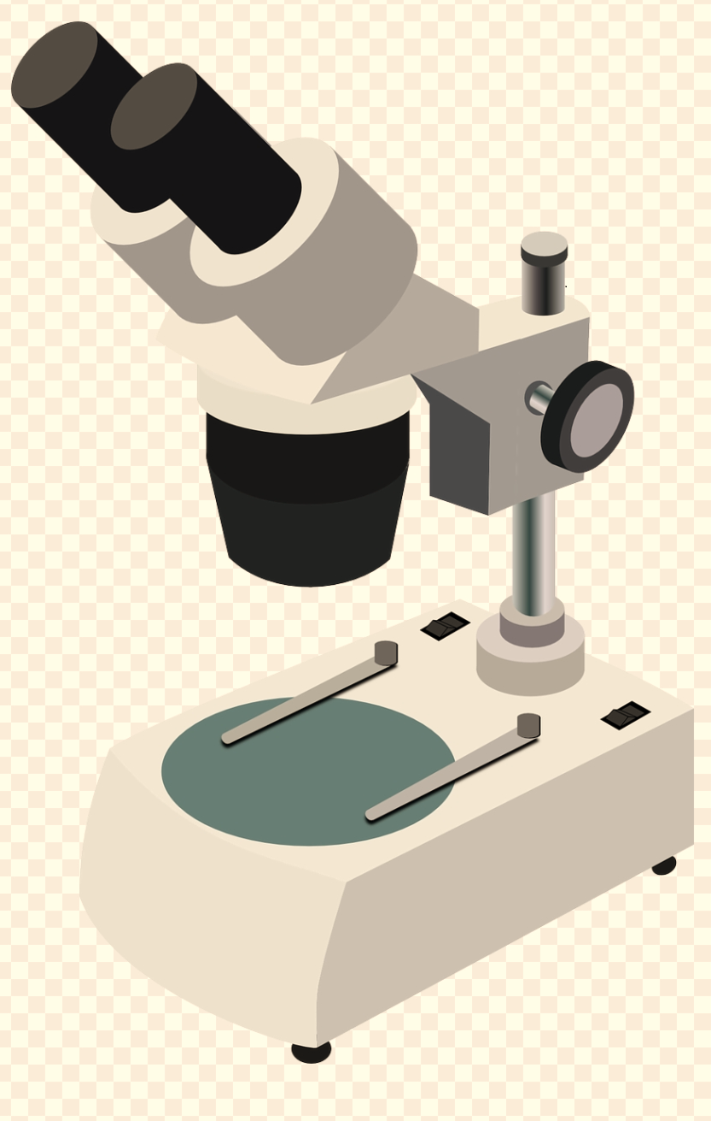
Introduction to Microbial Ecology
https://doi.org/10.1016/j.tim.2022.04.006
What is it?
Research focused on studying microbial life in the environment.
(Exploring the invisible worlds under our feet)
Why is it important?
Microbes perform crucial ecosystem services.
(healthy microbes = healthy soils)
?
How do we study it?
We use Next-Generation Sequencing (NGS) to look at the unculturable microbial majority.

Slide 7
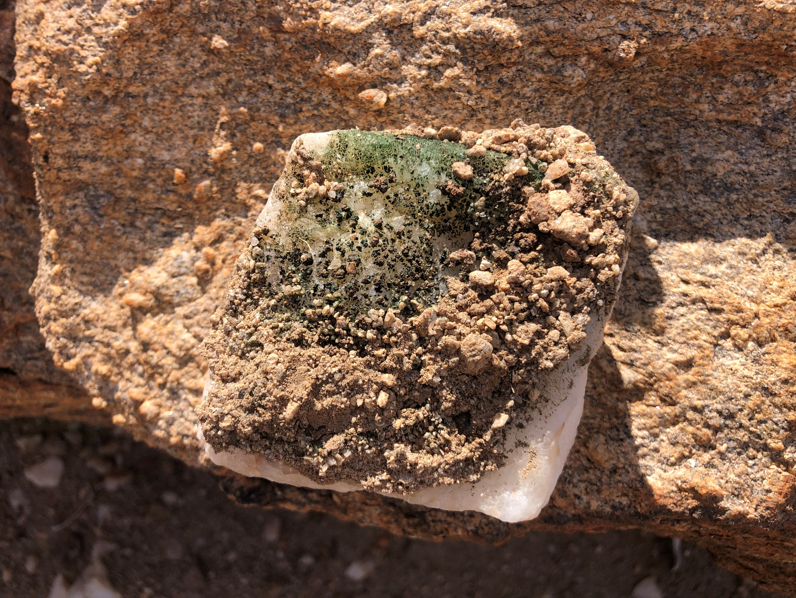
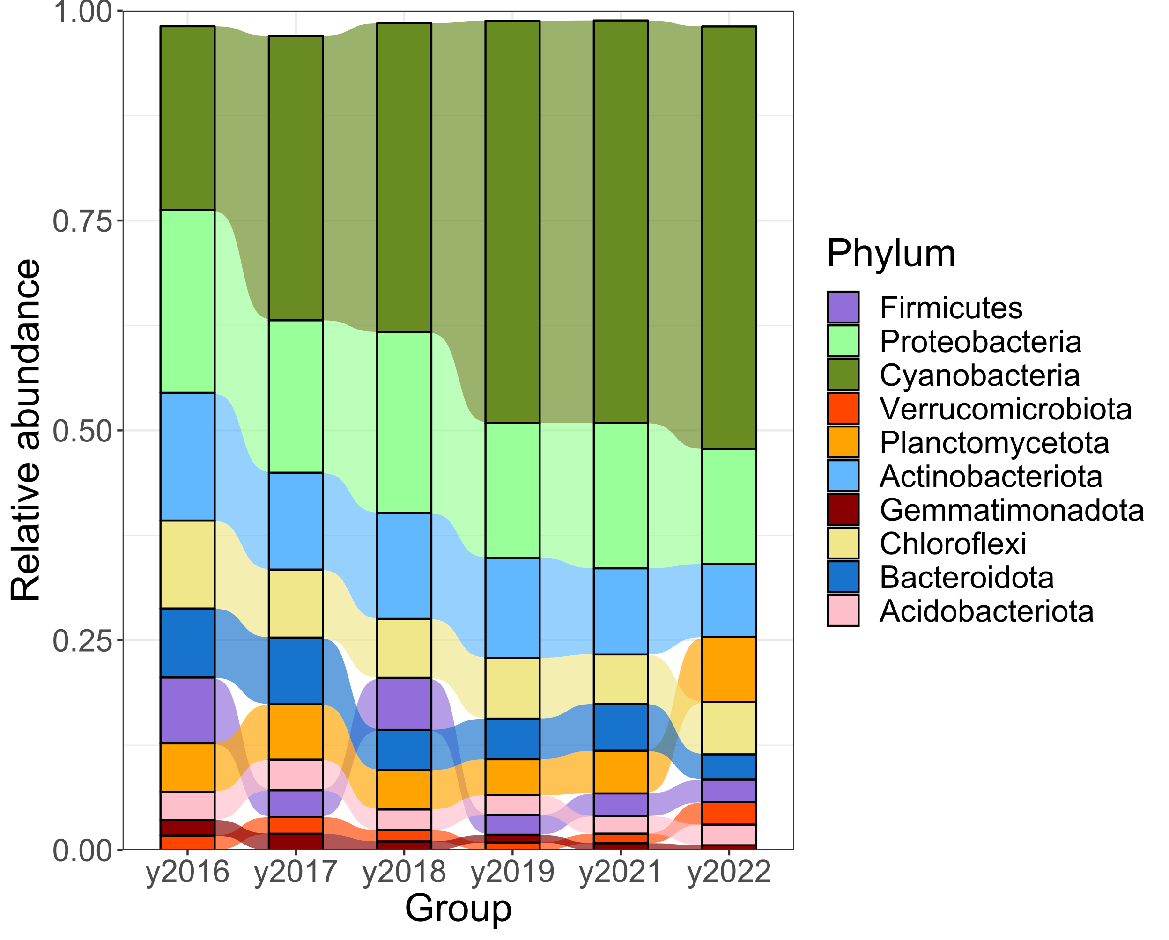
The Microbial Ecology of the Namib desert
Hypolith
The Namib desert is a hyper-arid ecosyste, with challenging conditions for most forms of life.
Microorganisms dominate and drive the nutrient cycles in this environment.
They live in the open soils as well as cryptic refugia.
By studying the microbial ecology of this system, we understand what microbes are important players in the ecosystem cycles.
Cyanobacteria

Slide 8
Next generation sequencing (NGS)
We use NGS platforms to look at the genetic material (DNA, RNA) in our environment.
NGS allows high-throughput parallel sequencing of many genetic fragments
Sanger sequencing methods sequence a single genetic fragment at a time.
Several approaches to NGS:
Amplicon (DNA): targeted sequencing of a gene marker.
Shotgun metagenomics (DNA): sequencing of total DNA in a sample
Transcriptomics (RNA): Sequencing of total RNA in a sample.
Who are they?
Taxonomy
Amplicon
Shotgun metagenomics
Response
Function
Transcriptomics
How are they doing it?
What are they doing?
Read more! https://doi.org/10.1038/nrg.2016.49

Slide 9
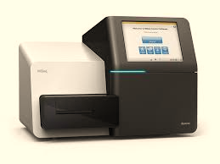
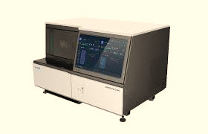
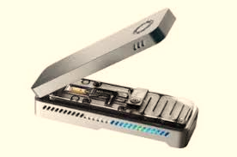
NGS platforms
There are different available platforms to perform NGS.
Short-read sequencing platforms (< 800 bps):
Illumina Miseq (300 bps) : Used in amplicon sequencing approaches.
Illumina Hiseq (150 bps): Used in shotgun metagenomics and transcriptomics approaches
Illumina Novaseq (150 or 250 bps): Higher throughput and lower cost than the other two technologies.
MGI (150 bps) : Low-cost alternative with lower error-rates
Long-read sequencing platforms( > 1Kbps):
PacBio: Used in shotgun metagenomics and can generate fragments above 20 Kb; sensitive to degraded DNA
Nanopore sequencers: Portable and can be used in-field; sensitive to quality of DNA extractions. Higher error-rates.
Read more! https://doi.org/10.1038/nrg.2016.49

Slide 10
Amplicon sequencing
Targeted to single genes that provide important information about your community:
E.g. sequencing of amoA genes to investigate the diversity of ammonia-oxidizing microorganisms
E.g. sequencing of 16S rRNA gene to assess the microbial diversity in an environment
Illumina Miseq is the most common technology used for this approach: cheap while generating reasonable fragment sizes (up to 550 bps)
Libraries are constructed via PCR: rely on the presence of conserved regions at the ends of the target sequence for the design of universal primers
Taxonomy marker genes are normally ribosomal RNA: highly abundant and conserved
16S rRNA: Prokaryotes / 18S rRNA: Eukaryotes
ITS1/ITS2: Mostly fungi
Target sequence
PCR
Capture diversity with a single primer set

Slide 11
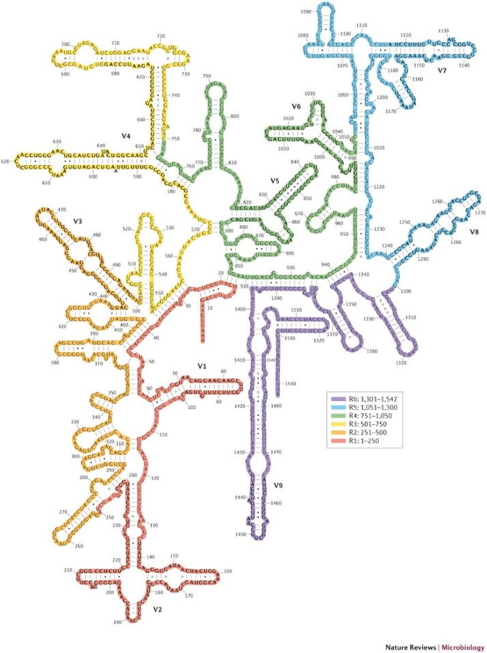
Know your target! 16S rRNA
First used by Carl Woese, instrumental in the restructuring of the prokaryotic tree of life and the inclusion of Archaea
16S rRNA, together with 19 other proteins, forms the small ribosomal subunit, which is essential for translation.
16S rRNA genes: DNA that codes for the RNA
16S rRNA transcripts: RNA
1,500 base pairs long
9 hypervariable regions
When sequencing using Miseq, the choice of hypervariable region is very important

Slide 12
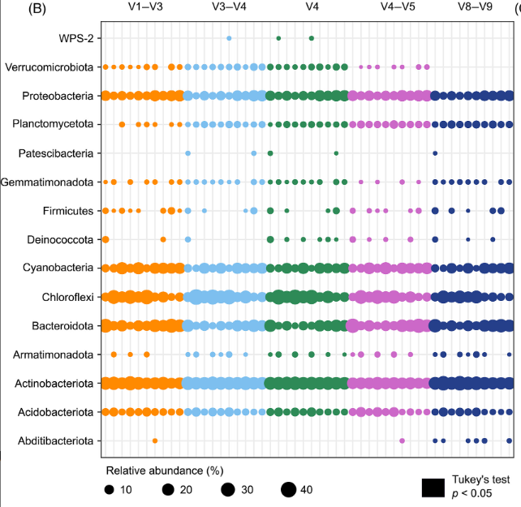
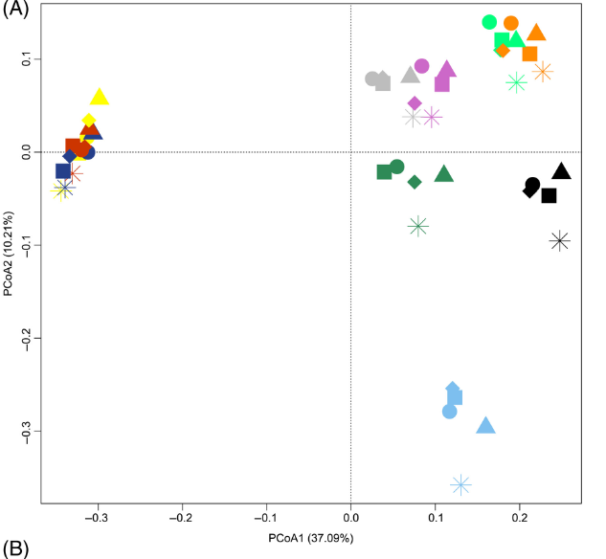
Everything matters: Primer selection
https://doi.org/10.1111/1758-2229.13145

Slide 13
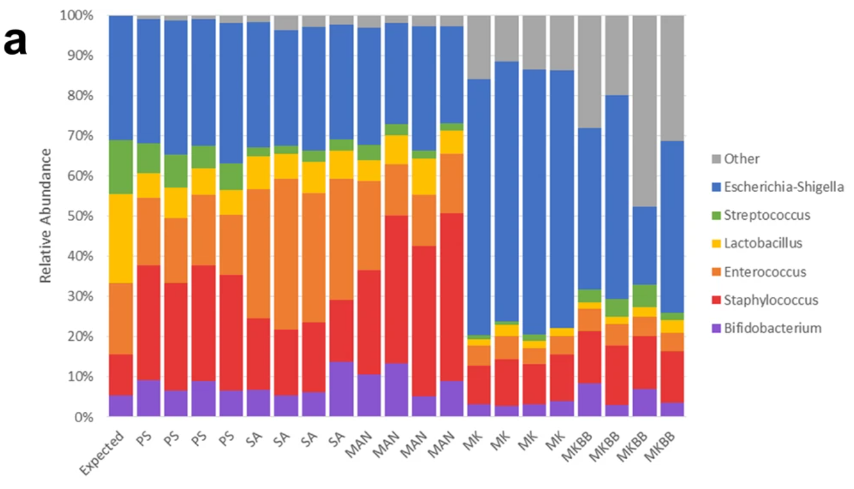
Everything matters: DNA extraction
DNA extraction from breastmilk
PS = DNeasy PowerLyzer PowerSoil DNA Isolation
SA = Sigma-Aldrich GenElute Bacterial Genomic DNA Kit
MAN = manual phenol-chloroform extraction method
MK = QIAamp DNA Stool Mini Kit
MKBB = QIAamp DNA Stool Mini Kit with bead beating
https://doi.org/10.1038/s41598-019-55568-y

Slide 14
Standardizing Microbial Ecology
V4-V5
In an effort to standardize Microbial Ecology studies, the Earth Microbiome Project was funded in 2010. (https://earthmicrobiome.org/)
Standardized DNA extraction and sequencing protocols.
Promote the use of V4 and V4-V5 hypervariable regions.
More recent global microbial biodiversity scientific networks include:
SoilBON: Global Soil Biodiversity Initiative (https://www.globalsoilbiodiversity.org/soilbon)
sIBTEDS: Illuminating Blindspots Through Equitable Data reuse practices in the global South (https://micoda.idiv.de/home.jsp)

Slide 15
sIBTEDS: Illuminating Blindspots Through Equitable Data reuse practices in the global South
Initiative to empower researchers from the under-represented global South with the tools to conduct bioinformatics-based microbial ecology studies.
This is done through:
Workshops: on-line workshops involving 100s of researcher (Datathons)
Online resources: Such as recordings and training materials
Technical support: Specialised members of the team will provide continued technical support.
Data resources: Sequence repository that researchers can use for analysis with standardized metadata.
South American Datathon happened in 2023. African Datathon will happen in Oct-Nov 2024!
You can be part of the network!

Slide 16
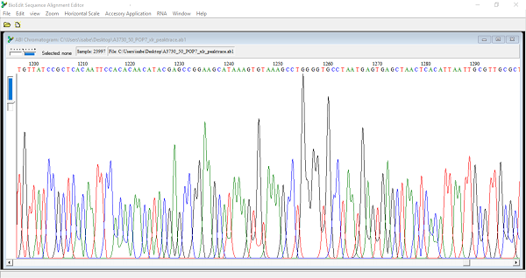
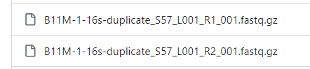
Data processing: Sequencing outputs
Data generated from the sequencing platforms is given in fastq format (fasta + quality of the base-calling)
For pair-end reads, you will have two files per samples:
_R1.fastq.gz (forward read)
_R2.fastq.gz (reverse read)
Our data
Exception: Oxford Nanopore technologies outputs are given in fast5 format – binary file containing fastq as well as other data.
Software such as Guppy can be used to

Slide 17
Data processing pipeline: solving a puzzle
Thousands to millions of reads
Remove primers
Quality filter
ASV inference
Merge
Chimera check
Assign taxonomy
Forward reads
Reverse reads

Slide 18
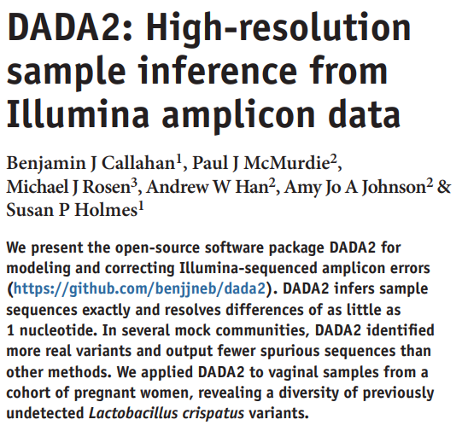
Who is dada2? What does it want from us?
Divisive Amplicon Denoising Algorithm
Model-based approach for correcting amplicon errors, resulting in inference of amplicon sequence variants (ASVs)
3 reads
Similarity
1 OTU
97%
3 reads
Quality
2 ASVs
✔
✔
X
https://doi.org/10.1038/nmeth.3869
Notes:
quality filtering and the construction of operational taxonomic units (OTUs): clusters of sequences that differ by less than a fixed dissimilarity threshold7–9 (typically 3%). Lumping together similar sequences reduces the rate at which errors are misinterpreted as biological variation
These approaches do not incorporate all the data, in particular sequence quality information and statistical information available on the reads were not incorporated into the assignments.
In contrast, the de novo read counts used here will be constructed through the incorporation of both the quality scores and sequence frequencies in a probabilistic noise model for nucleotide transitions

Slide 19

Resolution: DADA2 infers ASVs from amplicon data, resolving biological differences of even 1 or 2 nucleotides.
Accuracy: DADA2 reports fewer false positive sequence variants than other methods report false OTUs.
Comparability: The ASVs output by DADA2 can be directly compared between studies, without the need to reprocess the pooled data.
Computational Scaling: The compute time of DADA2 scales linearly sample number, and memory requirements are essentially flat.
Open Source
https://doi.org/10.1038/nmeth.3869
Callahan et al., Nat Methods, 2016

Slide 20
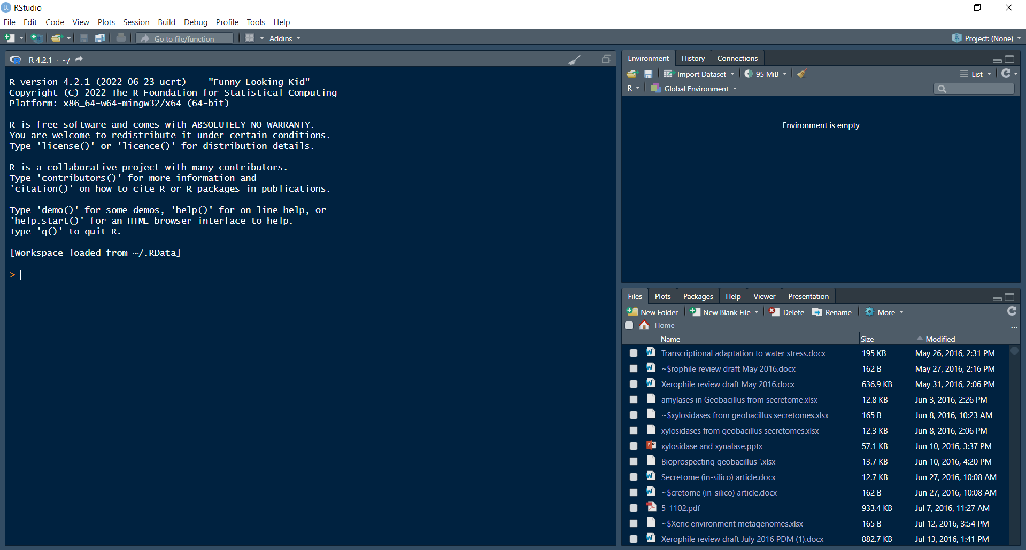
Rstudio: Bad at first impression, but your best friend
Environment
Where your loaded files and the ones you create will appear
Console
Where your commands will run
Very important
Where you can see your working directory, your plots, the installed packages, etc

Slide 21
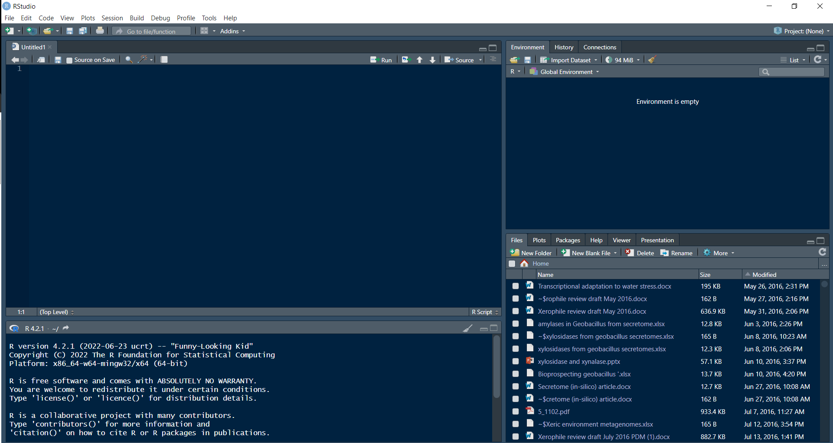
Rstudio: Don’t forget to start a new script
Click on the option to Create a new R script
A fourth Script window will appear. This is where you should write your commands. You can save them and load them back up next time you want to run the same analysis

Slide 22
Rstudio: How it works
Rstudio allows the user to run “programs” (called packages) in order to perform a variety of tasks, including sequence data processing, statistics, plotting graphs, etc….
Its open source and very well supported: lots of packages and tutorials on how to use these pakages.
Packages need to be loaded before running your commands every time you open Rstudio – this tells Rstudio what packages are you using.
Packages need to be installed before they can be loaded – installation only needs to happen once.
Scripts can be saved so that you preserve the analysis if you want to run it again

Slide 23
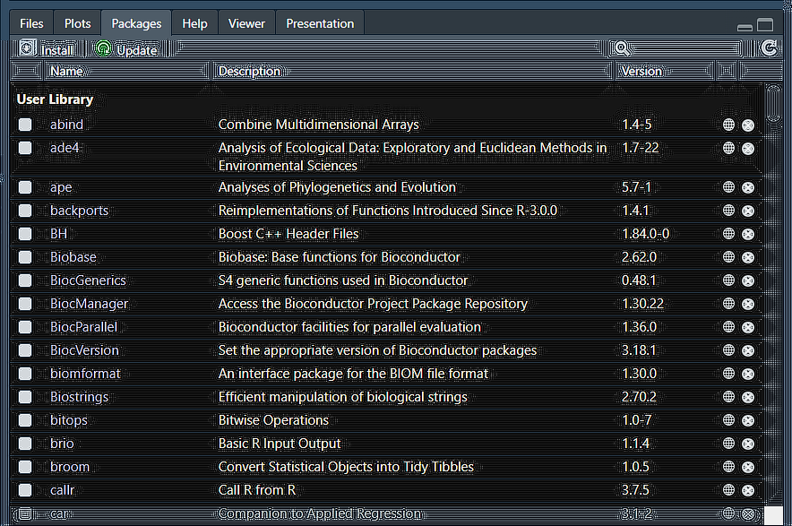
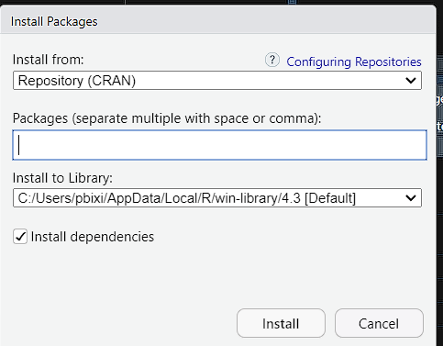
Rstudio: Installing packages using CRAN
Packages can be installed through two sources:
CRAN repository
Bioconductor repository
CRAN depository can
be accessed in Rstudio
If a package is not in the
repository, you need to access
it via Bioconductor
Clicking on install will access the CRAN database, from which most of our packages come from: Phyloseq, Vegan, ggplot2

Slide 24
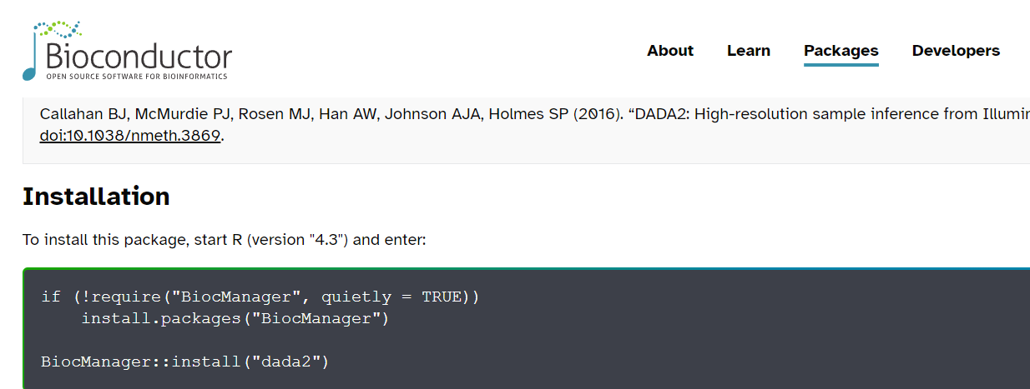
Rstudio: Bioconductor
Packages like DADA2 can be installed from Bioconductor
Easiest to google the name of the package followed by Bioconductor to find the intall page.
This is a command line you have to copy-paste to your script and run

Slide 25
Rstudio: How you make it work
Every time you want to run a script, you first have to load the packages that you are going to use:
Library(phyloseq) # this is how you load a package. The hash makes this line a comment
Command lines in Rstudio will use the following structure:
phyloseq(input, option 1, option 2, ….)
Name of package/function
Options are separated by a comma
Don’t forget to name your command. (No name = no save)
Name = phyloseq(input, option 1, option 2, ….)

Slide 26
Lets try it! Open RStudio
Make sure you have downloaded beforehand the sequencing data from:
https://github.com/PHLebre/Sailing_through_Microbial_Seas/tree/main/Sequencing%20data
Create a new script and set the working directory (very important):
setwd()
Need to get to the right directory?
setwd(“~/set/that/path/straight”) # I know a easier way, by using the Session > Set Working Directory option
Don’t forget to load your libraries (needs to happen every time):
library(dada2)
library(phyloseq)
library(vegan)
library(cowplot)
library(ggplot2)

Slide 27
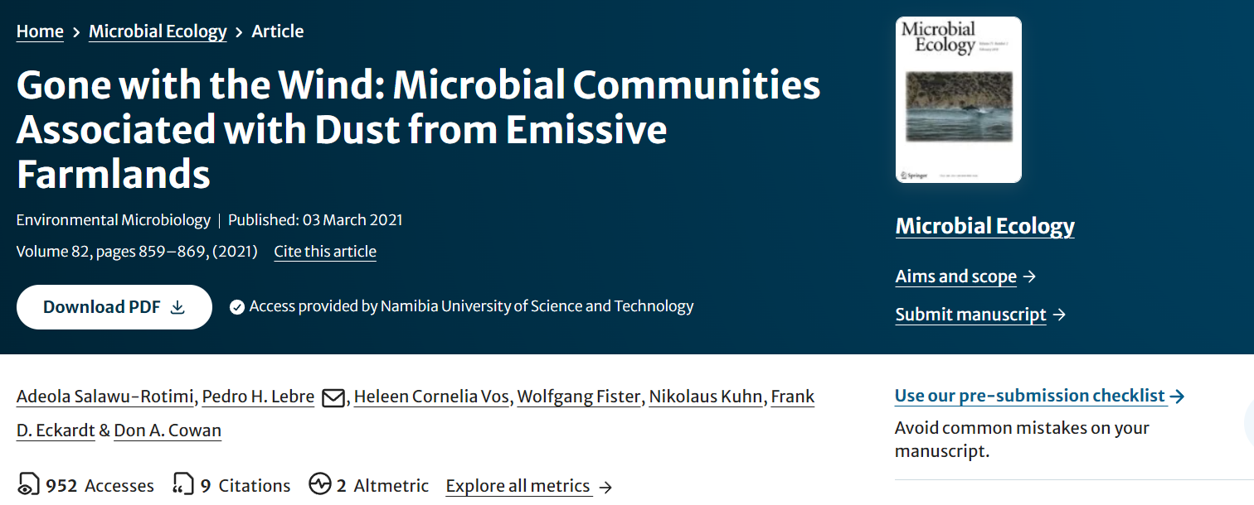
A note on our data

Slide 28
Tell dada2 where everything is!
path= getwd() #make sure you are in the right folder before!
fnFs= sort(list.files(path, pattern= “_R1_001.fastq.gz”))
fnRs= sort(list.files(path, pattern= “_R2_002.fastq.gz”))
INSPECT!
fnFs
What does this script do?
Match file order
Seek out files with specific ending to create a list

Slide 29
Let’s extract sample names
sample.names = sapply(strsplit(fnFs, “_001.fastq.gz "), `[`, 1)
Split file names, keep what is unique to each sample name (i.e., not the ending)
Check it !
sample.names

Slide 30
Create a location to place the processed sequences in.
#specify global path to the sequence files
fnFs = file.path(path, fnFs)
fnRs = file.path(path, fnRs)
Check it! fnFs

Slide 31
Filtering
Create a folder for filtered sequences to go in
filt_path= file.path(path, "filtered")
Place filtered files in filtered/ subdirectory
filtFs=file.path(filt_path, paste0(sample.names, "_1.filtered.fastq.gz"))
filtRs= file.path(filt_path, paste0(sample.names, "_2.filtered.fastq.gz"))

Slide 32
Plot sequence quality scores
First read in the first forward sample
Forwardpqp=plotQualityProfile(fnFs[1])
First read in the first reverse sample
Reversepqp=plotQualityProfile(fnRs[1])
Level up! Download package cowplot to plot them together with plot_grid.
Library(cowplot)
Qualityprof= plot_grid(Forwardpqp, Reversepqp, ncol=2)

Slide 33
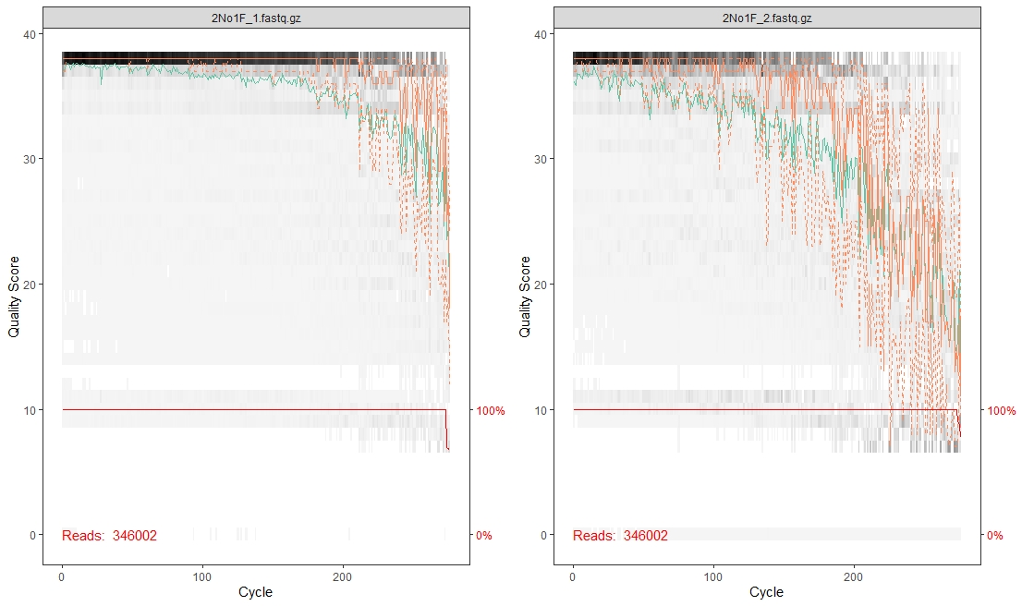
An image says a thousand words
Mean (quality)
Quartiles (quality)
Frequency (quality)
Quality
Base pair position
Notes:
In gray-scale is a heat map of the frequency of each quality score at each base position. The mean quality score at each position is shown by the green line, and the quartiles of the quality score distribution by the orange lines. The red line shows the scaled proportion of reads that extend to at least that position (this is more useful for other sequencing technologies, as Illumina reads are typically all the same length, hence the flat red line). The difference between a quality score of 40 and a quality score of 20 is an expected error rate of 1 in 10,000 vs 1 in 100.

Slide 34
The dip is natural!
“Illumina relies on the sequencing by synthesis procedure. During each cycle of the process the sequencer washes chemicals that include variants for all four nucleotide over the flow cell (which has different clusters with identical DNA fragments for each cluster). The nucleotides have a blocker (terminator cap) so that only 1 base gets added to each molecule of DNA at a time. After the detection of the coupled fluorescence signal the blocker can be removed and the cycle can start again. [over time] the blocker of a nucleotide is not correctly removed after signal detection. In the next cycle no new nucleotide can bind on this DNA fragment and the old nucleotide is detected one more time whereby the fluorescence signal of this old nucleotide (probably) differs from the synchronous signal of the other nucleotides (Fig. 2). From now on this DNA fragment will be 1 cycle behind the rest, polluting the light signal that the sequencer's camera has to read.”
https://www.ecseq.com/support/ngs/why-does-the-sequence-quality-decrease-over-the-read-in-illumina
Notes:
In gray-scale is a heat map of the frequency of each quality score at each base position. The mean quality score at each position is shown by the green line, and the quartiles of the quality score distribution by the orange lines. The red line shows the scaled proportion of reads that extend to at least that position (this is more useful for other sequencing technologies, as Illumina reads are typically all the same length, hence the flat red line).

Slide 35
The filterAndTrim function
Remove primers
Quality filter
ASV inference
Merge
Chimera check
Assign taxonomy
Forward reads
Reverse reads
Notes:
We denoise our sequences to remove and/or correct noisy reads. 🔊
We dereplicate our sequences to reduce repetition and file size/memory requirements in downstream steps (don’t worry! we keep count of each replicate). 🕵️
We cluster sequences to collapse similar sequences (e.g., those that are ≥ 97% similar to each other) into single replicate sequences. This process, also known as OTU picking, was once a common procedure, used to simultaneously dereplicate but also perform a sort of quick-and-dirty denoising procedure (to capture stochastic sequencing and PCR errors, which should be rare and similar to more abundant centroid sequences). Use denoising methods instead if you can. Times have changed. Welcome to the future.

Slide 36
The most important line in the pipeline
out=filterAndTrim(fnFs, filtFs, fnRs, filtRs, truncLen=c(240,220),trimLeft=10, maxN=0, maxEE=c(2,2), truncQ=2, rm.phix=TRUE, compress=TRUE, multithread=TRUE)
Notes:
DADA2 incorporates quality information into its error model which makes the algorithm robust to lower quality sequence, but trimming as the average qualities crash will improve the algorithm’s sensitivity to rare sequence variants. The maxEE parameter sets the maximum number of “expected errors” allowed in a read. If you want to speed up downstream computation, consider tightening maxEE. If too few reads are passing the filter, consider relaxing maxEE, perhaps especially on the reverse reads (eg. maxEE=c(2,5)), and reducing the truncLen to remove low quality tails.

Slide 37
Every parameter matters: primers
Can remove primers
out=filterAndTrim(fnFs, filtFs, fnRs, filtRs, truncLen=c(240,220),trimLeft=10, maxN=0, maxEE=c(2,2), truncQ=2, rm.phix=TRUE, compress=TRUE, multithread=TRUE)
Notes:
DADA2 incorporates quality information into its error model which makes the algorithm robust to lower quality sequence, but trimming as the average qualities crash will improve the algorithm’s sensitivity to rare sequence variants. The maxEE parameter sets the maximum number of “expected errors” allowed in a read. If you want to speed up downstream computation, consider tightening maxEE. If too few reads are passing the filter, consider relaxing maxEE, perhaps especially on the reverse reads (eg. maxEE=c(2,5)), and reducing the truncLen to remove low quality tails.

Slide 38
Notes:
In gray-scale is a heat map of the frequency of each quality score at each base position. The mean quality score at each position is shown by the green line, and the quartiles of the quality score distribution by the orange lines. The red line shows the scaled proportion of reads that extend to at least that position (this is more useful for other sequencing technologies, as Illumina reads are typically all the same length, hence the flat red line).

Slide 39
Every parameter matters: truncation length
out=filterAndTrim(fnFs, filtFs, fnRs, filtRs, truncLen=c(240,220),trimLeft=10, maxN=0, maxEE=c(2,2), truncQ=2, rm.phix=TRUE, compress=TRUE, multithread=TRUE)
Trim
Notes:
DADA2 incorporates quality information into its error model which makes the algorithm robust to lower quality sequence, but trimming as the average qualities crash will improve the algorithm’s sensitivity to rare sequence variants. The maxEE parameter sets the maximum number of “expected errors” allowed in a read. If you want to speed up downstream computation, consider tightening maxEE. If too few reads are passing the filter, consider relaxing maxEE, perhaps especially on the reverse reads (eg. maxEE=c(2,5)), and reducing the truncLen to remove low quality tails.

Slide 40
Notes:
In gray-scale is a heat map of the frequency of each quality score at each base position. The mean quality score at each position is shown by the green line, and the quartiles of the quality score distribution by the orange lines. The red line shows the scaled proportion of reads that extend to at least that position (this is more useful for other sequencing technologies, as Illumina reads are typically all the same length, hence the flat red line).

Slide 41
Every parameter matters: error checking
out=filterAndTrim(fnFs, filtFs, fnRs, filtRs, truncLen=c(240,220),trimLeft=10, maxN=0, maxEE=c(2,2), truncQ=2, rm.phix=TRUE, compress=TRUE, multithread=TRUE)
Quality
filter
Notes:
The maxEE parameter sets the maximum number of “expected errors” allowed in a read. Small E means high quality, large E means low quality. We can therefore filter low quality reads by setting a maximum number of expected errors (E_max) If you want to speed up downstream computation, consider tightening maxEE. If too few reads are passing the filter, consider relaxing maxEE, perhaps especially on the reverse reads (eg. maxEE=c(2,5)), and reducing the truncLen to remove low quality tails.

Slide 42
Every parameter matters: error checking
out=filterAndTrim(fnFs, filtFs, fnRs, filtRs, truncLen=c(240,220),trimLeft=10, maxN=0, maxEE=c(2,2), truncQ=2, rm.phix=TRUE, compress=TRUE, multithread=TRUE)
Remove PhiX sequences
Notes:
The maxEE parameter sets the maximum number of “expected errors” allowed in a read. Small E means high quality, large E means low quality. We can therefore filter low quality reads by setting a maximum number of expected errors (E_max) If you want to speed up downstream computation, consider tightening maxEE. If too few reads are passing the filter, consider relaxing maxEE, perhaps especially on the reverse reads (eg. maxEE=c(2,5)), and reducing the truncLen to remove low quality tails. Truncq will stop reading after quality reaches 2

Slide 43
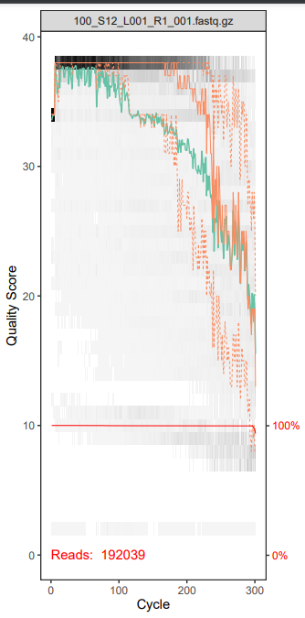
Trimming is a game of compromise
Trim ~10 bp?
Trim here? ~200 bp
200-10=190 bp fragments
500 bps
190 bps
190 bps
No merger

Slide 44
The learnErrors and dada functions
Remove primers
Quality filter
ASV inference
Merge
Chimera check
Assign taxonomy
Forward reads
Reverse reads
Notes:
We denoise our sequences to remove and/or correct noisy reads. 🔊
We dereplicate our sequences to reduce repetition and file size/memory requirements in downstream steps (don’t worry! we keep count of each replicate). 🕵️
We cluster sequences to collapse similar sequences (e.g., those that are ≥ 97% similar to each other) into single replicate sequences. This process, also known as OTU picking, was once a common procedure, used to simultaneously dereplicate but also perform a sort of quick-and-dirty denoising procedure (to capture stochastic sequencing and PCR errors, which should be rare and similar to more abundant centroid sequences). Use denoising methods instead if you can. Times have changed. Welcome to the future.

Slide 45
Generate an error model for the data
errF = learnErrors(filtFs, multithread=TRUE)
errR = learnErrors(filtRs, multithread=TRUE)
plotErrors(errF, nominalQ=TRUE)
Notes:
The learnErrors method learns this error model from the data, by alternating estimation of the error rates and inference of sample composition until they converge on a jointly consistent solution.

Slide 46
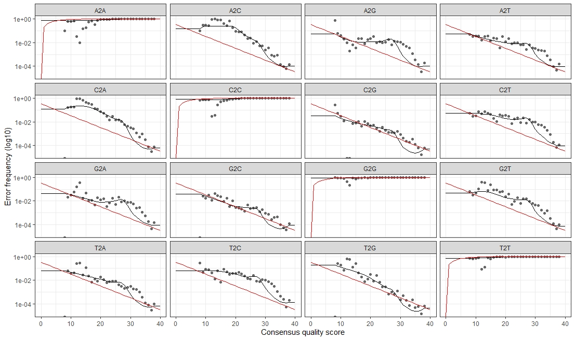
Checking for errors
Notes:
The error rates for each possible transition (A→C, A→G, …) are shown. Points are the observed error rates for each consensus quality score. The black line shows the estimated error rates after convergence of the machine-learning algorithm. The red line shows the error rates expected under the nominal definition of the Q-score. Here the estimated error rates (black line) are a good fit to the observed rates (points), and the error rates drop with increased quality as expected.

Slide 47
Infer ASVs
We assume each ASV is a unique “species” in the community
Error model
Frequency
Trimmed sequences
ASVs
dadaFs = dada(filtFs, err=errF, multithread=TRUE)
dadaRs = dada(filtRs, err=errR, multithread=TRUE)
Notes:
This step can be run on individual samples, which is the least computationally intensive manner, or on all samples together, which increases the function’s ability to resolve low-abundance ASVs. Imagine Sample A has 10,000 copies of sequence Z, and Sample B has 1 copy of sequence Z. Sequence Z would likely be filtered out of Sample B even though it was a “true” singleton among perhaps thousands of spurious singletons we needed to remove.

Slide 48
The mergePairs function
Remove primers
Quality filter
ASV inference
Merge
Chimera check
Assign taxonomy
Forward reads
Reverse reads
Notes:
We denoise our sequences to remove and/or correct noisy reads. 🔊
We dereplicate our sequences to reduce repetition and file size/memory requirements in downstream steps (don’t worry! we keep count of each replicate). 🕵️
We cluster sequences to collapse similar sequences (e.g., those that are ≥ 97% similar to each other) into single replicate sequences. This process, also known as OTU picking, was once a common procedure, used to simultaneously dereplicate but also perform a sort of quick-and-dirty denoising procedure (to capture stochastic sequencing and PCR errors, which should be rare and similar to more abundant centroid sequences). Use denoising methods instead if you can. Times have changed. Welcome to the future.

Slide 49
Merge forward and reverse reads
Merged ASV
x
Discard!
No singletons please
mergers = mergePairs(dadaFs, filtFs, dadaRs, filtRs, verbose=TRUE, minOverlap = 10)
This will result in longer final reads, and is another way of error-checking your sequences
Notes:
We now merge the forward and reverse reads together to obtain the full denoised sequences. Merging is performed by aligning the denoised forward reads with the reverse-complement of the corresponding denoised reverse reads, and then constructing the merged “contig” sequences.

Slide 50
Let’s start building our ASV table!
The ASV table displays the the counts (distribution) of each unique ASV per sample – most important output from DADA2 !
seqtab <- makeSequenceTable(mergers)
Check out the table!
dim(seqtab)
colnames(seqtab)
row.names(seqtab)
This table is not 100% ready to use yet!

Slide 51
The removeBimeraDenovo function
Remove primers
Quality filter
ASV inference
Merge
Chimera check
Assign taxonomy
Forward reads
Reverse reads
Notes:
We denoise our sequences to remove and/or correct noisy reads. 🔊
We dereplicate our sequences to reduce repetition and file size/memory requirements in downstream steps (don’t worry! we keep count of each replicate). 🕵️
We cluster sequences to collapse similar sequences (e.g., those that are ≥ 97% similar to each other) into single replicate sequences. This process, also known as OTU picking, was once a common procedure, used to simultaneously dereplicate but also perform a sort of quick-and-dirty denoising procedure (to capture stochastic sequencing and PCR errors, which should be rare and similar to more abundant centroid sequences). Use denoising methods instead if you can. Times have changed. Welcome to the future.

Slide 52
One final bit of cleanup: chimera checking
Chimeric ASV from 2 different species
seqtab.nochim <- removeBimeraDenovo(seqtab, method="consensus", multithread=TRUE, verbose=TRUE)
What percentage of reads are likely chimeras?
1- (sum(seqtab.nochim)/sum(seqtab))
What percentage of ASVs are likely chimeras?
1- (dim(seqtab.nochim)[2]/dim(seqtab)[2])
Notes:
DADA2 identifies likely chimeras by aligning each sequence with those that were recovered in greater abundance and then seeing if there are any lower-abundance sequences that can be made exactly by mixing left and right portions of two of the more-abundant ones. These are then removed

Slide 53
Reads will be lost, but how many?
getN <- function(x) sum(getUniques(x))
track <- cbind(out, sapply(dadaFs, getN), sapply(dadaRs, getN), sapply(mergers, getN), rowSums(seqtab.nochim))
colnames(track) <- c("input", "filtered", "denoisedF", "denoisedR", "merged", "nonchim")
rownames(track) <- sample.names
head(track)
write.table(track, “tracking.table.txt”, header=TRUE, sep=“\t”)

Slide 54
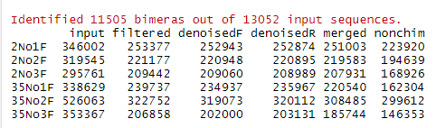
Loss is always inevitable !

Slide 55
Troubleshooting
Problem | Solution
Most reads are lost during merging | Fragments are too short. Either run the whole protocol without merging (i.e., only forward reads) or lengthen your reads
Most reads are lost during chimera checking | Primers or other technical nucleotides are likely still in the sample. Trim a bit more!

Slide 56
The assignTaxonomy function
Remove primers
Quality filter
ASV inference
Merge
Chimera check
Assign taxonomy
Forward reads
Reverse reads
Notes:
We denoise our sequences to remove and/or correct noisy reads. 🔊
We dereplicate our sequences to reduce repetition and file size/memory requirements in downstream steps (don’t worry! we keep count of each replicate). 🕵️
We cluster sequences to collapse similar sequences (e.g., those that are ≥ 97% similar to each other) into single replicate sequences. This process, also known as OTU picking, was once a common procedure, used to simultaneously dereplicate but also perform a sort of quick-and-dirty denoising procedure (to capture stochastic sequencing and PCR errors, which should be rare and similar to more abundant centroid sequences). Use denoising methods instead if you can. Times have changed. Welcome to the future.

Slide 57
Choose your weapon: assigning taxonomy
RDP (ribosomal database project) - 4,779 RNA sequences from 2,487 organisms
SILVA: comprehensive, quality checked and regularly updated datasets of aligned 16S and 18S rRNA – latest version 138.1 includes 2,224,740 SSU reference sequences
Not updated since 2019
GTDB (Genome taxonomy database): 46891 bacteria and 2812 archaea full 16S rRNA gene sequences. (updated in 2023)
RefSeq (NCBI Reference sequence database): 22433 bacterial, 1055 archaea and 99 eukaryotic full lengths16S rRNA gene sequences (updated in 2020).
Can download DADA2 formatted datasets from https://zenodo.org/records/10403693 and https://benjjneb.github.io/dada2/training.html

Slide 58
Assign taxonomy
Download one of the databases from the github page or one of the links
taxa <- assignTaxonomy(seqtab.nochim, “silva_nr99_v138.1_train_set.fa.gz", multithread=TRUE, tryRC=TRUE )
Clean up this object
taxa=as.data.frame(taxa)
taxa[] <- lapply(taxa, as.character)
How many unknowns did you get?
We will explore this data on the 3rd day
This is where you define your reference dataset
Notes:
taxa <- addSpecies(taxa, “silva_species_assignment_v138.1.fa.gz")

Slide 59
Time to wrap-up: Let’s export the data!
Write.csv(seqtab.nochim, “asv_table.csv”)
Write.csv(taxa, “taxonomy.csv”)
Don’t forget to save your script and your environment!

